Slide 1
Research Methods in
Pharmacology & Toxicology
Lecture 1 part II: Exploratory Data Analysis I
La Creis Renee Kidd, Ph.D., M.P.H.
Associate Professor
Pharmacology & Toxiciology
505 S. Hancock St. 40202, Room 306
Lab: 852-1547
lrkidd01@louisville.edu

Slide 2
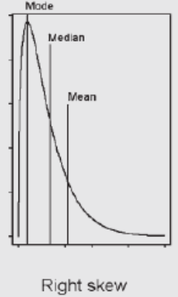
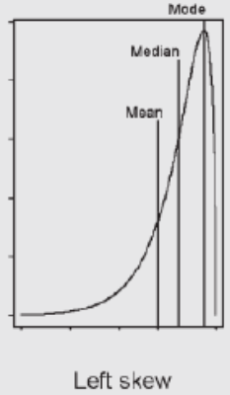
Skewness
Definition: A measure of the asymmetry of a frequency distribution
Guidelines for interpreting skewness coeffcient values
    If skewness coefficient (G) is between (-0.5, 0.5), then normal
    If G lies between (-0.5, -1) or (0.5, 1), then moderately skewed
    If G <-1 or G >1, then data is heavily skewed
Central Tendency Parameters give us a hint about skewness

Slide 3
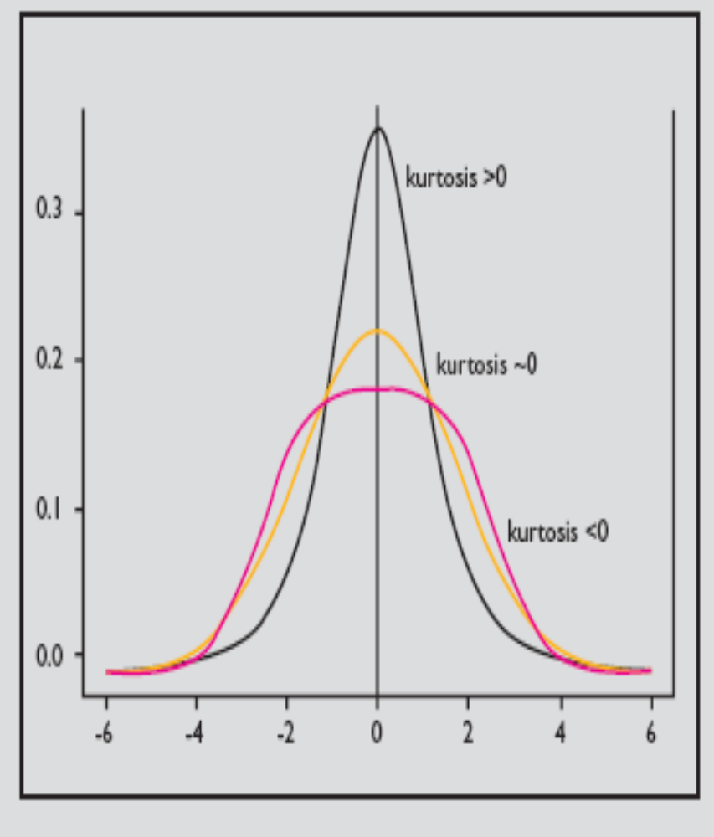
Kurtosis
A measure of the shape of the frequency distribution
Kurtosis ~ 0, normal
Kurtosis >0, acute peak & fat tails
Kurtosis <0, smaller peak & thin tails
Notes:
Normality should not be based on skewness alone.
Kurtosis meaures the peakness of the bell-curve. The acceptable range for normality is kurtosis lying between -1 to 1.
Distributions with zero kurtosis are called mesokurtic. The most common example of mesokurtic distribution is the normal distribution family.
Distributions with a positive kurtosis is called leptokurtic. A leptokurtic distribution has a more acute “peak” around the mean (that is a higher probability than a normally distributed variable of values near the mean) and “fat tails” (that is, a higher probability than a normally distributed variable of extreme values). Such a distribution is termed “super Gaussian”.
A distribution with negative kurtosis is called platykurtic. This distribution has a smaller peak around the mean and thin tails. Such a distribution is termed “sub Gaussian”.

Slide 4
Organize, Visualize, Explore Data
Frequency Distribution
Stem & Leaf Plot
  Visualize the overall distribution of the data, measures of centrality, spread (range)
Whisker Box Plot
  Visualize the overall distribution of the data, measures of centrality (mean, median), spread (range, IQR), outliers, obtain common percentiles
Notes:
Today I will introduce you to 2 graphical tools to check for normality. These tools also help you to quickly ascertain measures of centrality & spread, obtain percentiles, and determine whether your data set has outliers (i.e., extremely high or low values).
Before we explore some data using stem & leaf and whisker box plots, let’s discuss a tool used to organize your data (i.e., frequency distribution table).

Slide 5
Frequency Distribution
Definition
  The frequency distribution is an ordered display of each value in a data set together with the number of times that value occurs in the data set (i.e., frequency).
  In addition, the percentage of sample points that take on a particular value is also typically given.

Slide 6
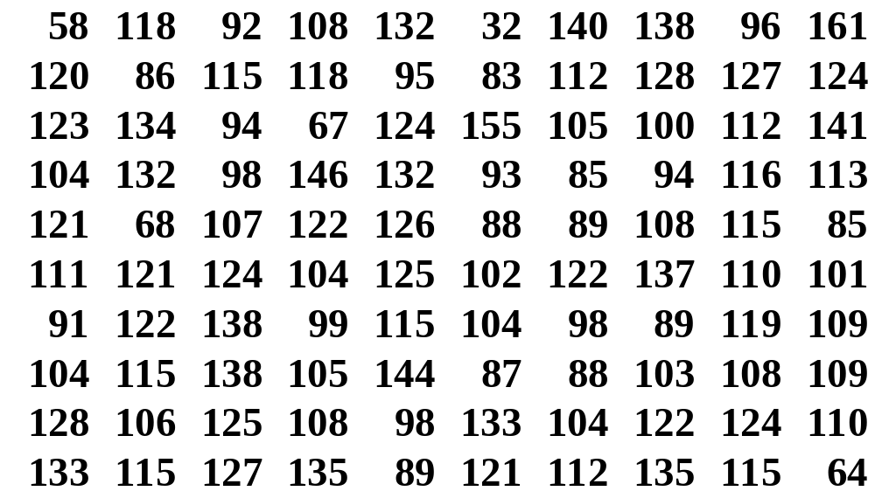
Table 1. Sample of Birthweights (oz.) from 100 Consecutive Deliveries

Slide 7
Frequency Distribution Table of Birthweight (see Appendix A)
A frequency distribution of the sample of 100 birthweights in Table 1 was generated using a SAS program.
For Each Birthwgt,The Proc Freq SAS code provides:
  the frequency (count)
  relative frequency (percent) = 100 x count/n
  cumulative frequency (cumulative count)
  cumulative percent = 100 x cumcount/n
Notes:
For each birthwgt presented in the sample, the proc freq sas code provides the # of counts, percent, cumulative count, and the cumulative percentage a particular value takes on within a sample set

Slide 8
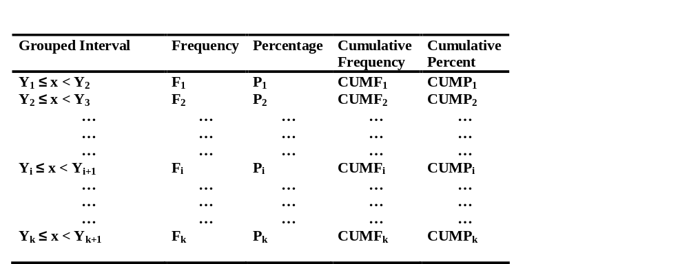
Guidelines for Creating Categories for Birthweight Data
Notes:
Subdivide the data into k intervals, starting at some lower boundary y₁ and ending at some upper bound y_{k+1}. Use the formula (2*n^{1/2}) to estimate the number of categories. Alternatively, you may use logic or accepted definitions to define your categories.
The first interval is from y1 inclusive to y₂ exclusive. The second interval is from y₂ inclusive to y₃ exclusive…. The kth and last interval is from yk inclusive to y_{k+1} exclusive. The rationale for this representation is to make certain that the group intervals include all possible values and do not overlap. These errors are common in the presentation of grouped data.
A count is made of the number of units that fall in each interval, which is denoted by the frequency within that interval.
In addition, the percentage, cumfreq, and cumulative percentage can also be presented in the freq distrib table.
The group intervals are generally chosen to be equal, although the appropriateness of equal group sizes should be dictated more by subject-matter considerations.

Slide 9
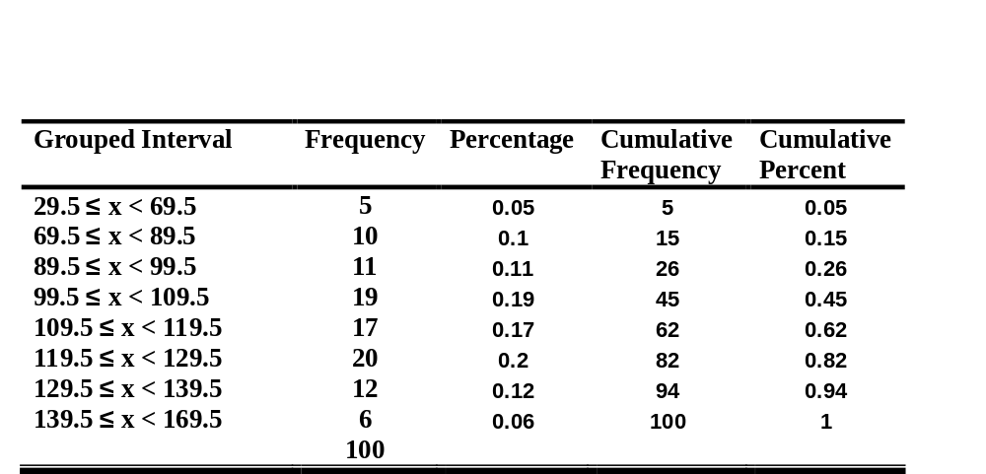
Grouped Frequency Distribution Table of Birthweight (oz) from 100 Consecutive Deliveries

Slide 10
Organize, Visualize, Explore Data
Frequency Distribution
Stem & Leaf Plot
  Visualize the overall distribution of the data, measures of centrality, spread (range)
Whisker Box Plot
  Visualize the overall distribution of the data, measures of centrality (mean, median), spread (range, IQR), outliers, obtain common percentiles

Slide 11
Stem & Leaf Plot (see Appendix A)
Why is a stem & Leaf Plot useful?
  Aid in sorting or ordering data
  Determine Minimum Value, Maximum Value, Range, Median, Interquartile Range, Mode
  Helps to determine whether the underlying distribution of the data (normal vs. skewed)
Rough guide for number of stems
  2 * n^{1/2}
  Or consider using logical categories
How to contruct a stem & Leaf Plot?
  Fund of Biostat, section 2.8.3, page 30

Slide 12
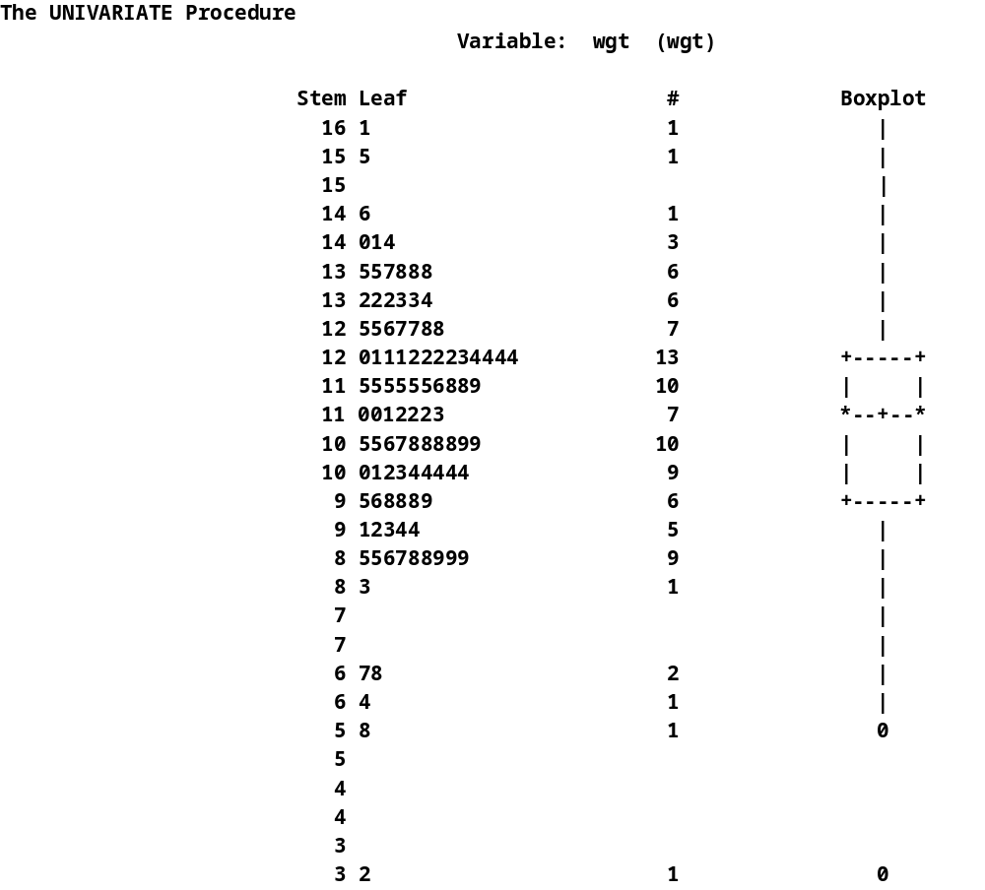
Notes:
Take a look at the stem leaf plot. Notice, the stem component at the left of the display consists of the number formed by all but the rightmost digit of the number. The leaf consist of the rightmost digit. The smallest stem may appear in the lower-left or upper-left hand corner of the plot. The stem and leaf component of the plot are separated by a vertical bar.
Examples: 6|7 = 67; 12|5 = 125

Slide 13
Problem 1
Given the Stem Leaf Plot of 100 Infant Births, calculate (show all formulas and all your work):
  Minimum value
  Maximum value
  Range
  Mean
  Median
  Mode
  Upper Quartile (i.e., 75th percentile)
  Lower Quartile (i.e., 25th percentile)
  Interquartile Range (IQR)
  Upper Fence
  Lower Fence
Notes:
Min: 32
Max: 161
Range: 129
Mode: 115

Slide 14
Problem 2
What is the underlying distribution of infant birthweight?
Notes:
Left skew – negatively skewed.

Slide 15
Organize, Visualize, Explore Data
Frequency Distribution
Stem & Leaf Plot
  Visualize the overall distribution of the data, measures of centrality, spread (range)
Whisker Box Plot
  Visualize the overall distribution of the data, measures of centrality (mean, median), spread (range, IQR), outliers, obtain common percentiles

Slide 16
Box Plot
Why is a box plot useful?
  Aid in sorting, ordering and interpreting data
  Determine Median, Range, Interquartile range, outliers
  Helps to determine whether the underlying distribution of the data set follows a bell shaped curve
  Helps to determine the degree of skewness (deviation from a bell shaped curve)
  Helps to identify possible outlying values

Slide 17
Box Plot
whiskers
25%
Terminology (If n*percentile/100 = interger)
  Upper Quartile = Q₃ = avg of [3n/4 + (3n/4 +1)]^{th} observation,
    75th percentile
  Median = Q₂ = avg of [n/2 + (n/2 +1)]^{th} observation
    50th percentile
  Lower Quartile = Q₁ = avg of [n/4 + (n/4 +1)]^{th} observation
    25th percentile
  Interquartile Range (IQR) = Q₃-Q₁
  Whiskers = lines drawn to the smallest and largest observations within the calculated fences
  Upper Fence = Upper Quartile + (1.5*IQR)
  Lower Fence = Lower Quartile – (1.5*IQR)
Q₃
25%
IQR
Q₂
25%
Q₁
25%
Notes:
The upper and lower quartiles are equivalent to 75th and 25th percentiles. Whereas, the median or Q2 is equivalent to the 50th percentile.
25% of ordered data points within a sample set fall: (a) below Q1; (b) between the median and the lower quartile; (c) between the median and the upper quartile; (d) above Q3

Slide 18
Box Plot
Terminology
  Outliers are data values beyond the fences (high or low)
    X > Upper Fence
    X < Lower Fence
whiskers
Q₃
IQR
Q₂
Q₁
Notes:
Outliers are data points inconsistent with the rest of the data.
An outlying value is a value x such that either
X > upper fence or X < lower fence

Slide 19
Box Plot
high values
Q₃ _{upper quartile}
Q_{2 median}
Q_{1 lower quartile}
low values
Mean is shifted
toward lower values
Skewed to the left
Negatively Skewed
Mean is shifted
toward higher values
Skewed to the right
Positively Skewed
Mean = Median = Mode
Normal Distribution
Notes:
A box plot uses the relationships among the median, upper quartile to describe the skewness of the data.
If the distribution is normally distributed, then the upper and lower quartiles will be equidistance from the median.
If the lower quartile is farther from the median than the upper quartile, then the distribution is negatively skewed (i.e., the distribution is shifted toward lower values). Notice in the second plot case, the median is shifted toward lower values.
If the upper quartile is farther from the median than the lower quartile, then the distribution is positively skewed (i.e., the distribution is shifted toward higher values). Notice in the third plot case, the median is shifted toward higher values.

Slide 20
Organize, Visualize, Explore Data
Frequency Distribution
Stem & Leaf Plot
  Visualize the overall distribution of the data, measures of centrality, spread (range)
Whisker Box Plot
  Visualize the overall distribution of the data, measures of centrality (mean, median), spread (range, IQR), outliers, obtain common percentiles

Slide 21
Commonly Used Percentiles
Deciles
  10, 20, …, 90%
Quintiles
  20, 40, …, 80%
Quartiles
  25, 50, 75%
Tertiles
  33.3%, 66.7%

Slide 22
How to Calculate Percentiles?
If [np/100] is an integer
  p^{th} percentile = avg of np _{th} ₊ np _{th +} 1 largest obsvervation
  ¹⁰⁰ ¹⁰⁰
If [np/100] is not an integer
  p^{th} percentile = np _{th +} 1 largest observation
  ¹⁰⁰
Notes:
An integer – is a whole number with no fractions

Slide 23
Problem 3
Use infant birthweight to calculate the 75th percentile (Q₃, upper quartile)
Is np/100 an integer? Yes
Then the 75th percentile equals the average between np^{th}/100 + (np^{th}/100 +1) largest observation
Q₃ = (124 + 125)/2 = 124.5 ounces

Slide 24
Likely Sources of Outliers
Data Entry Errors
“Rare” Event Syndrome
Notes:
DATA ERRORS – When looking for the source of outlying observations, first check for data recording or entry errors. To reduce the occurrence of data recording errors, use a spreadsheet program such as EXCEL for data entry. With large datasets, computer programs can be written to identify data entry errors. SAS is a particularly good tool for this purpose.
“Rare” Event Syndrome – Another reason for outliers is the “rare” event syndrome – extreme observations that for some legitimate reason do not fit within the typical range of other data values. Such unusual observations might include (e.g., extremely high urinary levels of a meat-derived carcinogen – individual may have consumed two well done grilled burgers)

Slide 25
Why are Outliers a Problem?
Statistical test based on sample means and variances can be distorted
Linear Regression Analysis models are sensitive to outliers
Distortion of p-values
Bias statistical inferences or conclusions
Notes:
Why Are They a Problem?
Developing techniques to look for outliers and understanding how they impact data analysis are
extremely important parts of a thorough analysis, especially when statistical techniques are applied to the data.
For example, in the presence of outliers, any statistical test based on sample means and variances can be distorted. Estimated regression coefficients that minimize the Sum of Squares for Error(SSE) are very sensitive to outliers.
There are several other problematic effects of outliers, including
bias or distortion of estimates inflated sums of squares (which make it unlikely you'll be able to partition sources of variation in the
data into meaningful components)
distortion of p-values (statistical significance, or lack thereof, can be due to the presence of a few—or even one—unusual data value)
faulty conclusions (it's quite possible to draw false conclusions if you haven't looked for indications that there was anything unusual in the data)

Slide 26
How to Handle Outliers?
Transform your data, but proceed with caution.
Correct Faulty Data Entry
Analyze your data with and without the outlier. Assess whether removal of the outlier alters your exploratory data analysis or your overall statistical conclusions and inferences about the data.
Use Nonparametric statistical tools to analyze your data.
Notes:
Neither ignoring unusual data values nor deleting them at will is a good solution. Here are some suggestions for keeping your data--and your conclusions--on track.
It's an unfortunate fact of life that data are not well-behaved. "Outliers"--unusual data values--crop up in most research projects involving data collection.
This is especially true in observational studies where data may naturally have unusual values, even if they come from reputable sources. Data entry errors or rare events (such as a thermometer left in the sun, a change in accounting practices, or a subject who has a sudden muscle spasm)--all these and many more are reasons for outliers to exist in a dataset.
Transformation. Transforming data is one way to soften the impact of outliers since the most commonly used expressions, square roots and logarithms, shrink larger values to a much greater extent than they shrink smaller values. However, transformations may not fit into the theory of the model or they may affect its interpretation. Taking the log of a variable does more than make a distribution less skewed; it changes the relationship between the original variable and the other variables in your model. In addition, most commonly used transformations require non-negative data or data that is greater than zero, so they are not always the answer.
Correct Faulty Data Entry If a value in a data set was entered incorrectly, then replace the outlier with the correct value.
Deletion. Only as a last resort should you delete outliers, and then only if you find they are legitimate errors that can't be corrected, or lie so far outside the range of the remainder of the data that they distort statistical inferences. When in doubt, you can report model results both with and without outliers to see how much they change.
Data transformations and deletion are important tools, but they shouldn't be viewed as a cure-all for distributional problems associated with outliers. Transformations and/or outlier elimination should be an informed choice, not a routine task.
Accommodation. One very effective plan is to use methods that are robust in the presence of outliers.
Nonparametric statistical methods fit into this category and should be more widely applied to continuous or interval data. When outliers are not a problem, simulation studies have indicated their ability to detect significant differences is only slightly smaller than corresponding parametric methods. There are also various forms of robust regression models and computer intensive approaches that deserve attention.

Slide 27
How to Handle Outliers?
(continued)
Transform your data, but proceed with caution.
Correct Faulty Data Entry
Analyze your data with and without the outlier. Assess whether removal of the outlier alters your exploratory data analysis or your overall statistical conclusions and inferences about the data.
Use Nonparametric statistical tools to analyze your data.
Notes:
Correct Faulty Data Entry If a value in a data set was entered incorrectly, then replace the outlier with the correct value.
Deletion. Only as a last resort should you delete outliers, and then only if you find they are legitimate errors that can't be corrected, or lie so far outside the range of the remainder of the data that they distort statistical inferences. When in doubt, you can report model results both with and without outliers to see how much they change.
Data transformations and deletion are important tools, but they shouldn't be viewed as a cure-all for distributional problems associated with outliers. Transformations and/or outlier elimination should be an informed choice, not a routine task.
Accommodation. One very effective plan is to use methods that are robust in the presence of outliers.
Nonparametric statistical methods fit into this category and should be more widely applied to continuous or interval data. When outliers are not a problem, simulation studies have indicated their ability to detect significant differences is only slightly smaller than corresponding parametric methods. There are also various forms of robust regression models and computer intensive approaches that deserve attention.

